Slide 1
Course Capstone
Data Collection

Slide 2
Finding the Middle
Mean, Median, and Mode help you compare data. Below, list the mean, median, and mode of the clicks in the provided data.
Mean: 60,38356164
Median: 60
Mode: 78

Slide 3
Finding the Middle
Mean, Median, and Mode help you compare data. Below, list the mean, median, and mode of the conversions in the provided data.
Mean: 5,980821918
Median: 6
Mode: 5

Slide 4
Standard Deviation
Determining variance in data helps you [know how much a data point deviates from the mean with the same unit as the original data]. Below, enter the standard deviation of the provided data.
Standard Deviation of Clicks: 14,36822476
Standard Deviation of Conversions: 1,62810629

Slide 5
Frequency and Contingency Tables
Understanding how often something happens is important to understanding trends and patterns in your data. Create and insert a contingency table generated from your data.
 | Number of AdWords Ad Clicks by Grouping for 2023
Number of AdWords Ad Clicks | 10 to 59 | 60 to 109 | 110 to 159 | 160+
Number of Occurrences | 182 | 183 | 0 | 0
 | Number of AdWords Ad Conversions by Grouping for 2023
Number of AdWords Ad Conversions | 1 to 5 | 6 to 10 | 11 to 15 | 16+
Number of Occurrences | 156 | 209 | 0 | 0

Slide 6
Scatter Plot
Understanding the relationships between data is important to understanding trends and patterns. Create and insert a scatter plot generated from your data. Then, include the input the correlation coefficient as well.
Scatter Plot of your data:
Correlation coefficient: 44,80%

Slide 7
End of Module 1

Slide 8
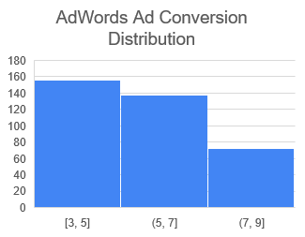
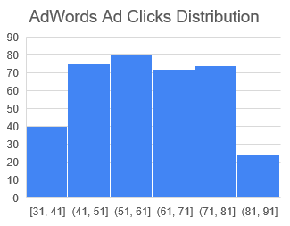
Sample Type
It’s important to understand the sample you’re using in your analysis. Fill in the information below about the sample you have received:
Histogram of your clicks data:
Histogram of conversions data:

Slide 9
Module 2: Sample Type
It’s important to understand the sample you’re using in your analysis. Fill in the information below about the sample you have received:
Does the clicks data have a normal distribution? Yes
Does the conversions data have a normal distribution? No

Slide 10
Variable Types
Determining the types of variables your working with is an important skill. Below, list the variables from your data that are:
Quantitative:
Continuous: AdWords Click-Through Rate, AdWords Conversion Rate, AdWords Cost per Click
Discrete: AdWords Ad Views, AdWords Ad Clicks, Cost per AdWords Ad
Qualitative:
Nominal: xx
Ordinal: xx

Slide 11
End of Module 2

Slide 12
Question and Hypothesis
The question you hope to answer and your hypothesized answer are necessary to complete an analysis. Answer the following questions
What is your hypothesis based off the evaluation question?
Our number of conversions will be greater if we advertise on the Facebook platform rather than the AdWords platform.

Slide 13
Question and Hypothesis
The question you hope to answer and your hypothesized answer are necessary to complete an analysis. Answer the following questions
What is your independent variable?
-The advertising platform: Facebook
-The advertising platform: AdWords
What is your dependent variable?
-The number of conversions

Slide 14
Running a Test
With your question and hypothesis ready, run the test on the two sets of data. Fill in the information below.
Mean number of Facebook conversions: 11,74246575
Mean number of Adware conversions: 5,980821918
p-Value: 4,5597E-146

Slide 15
Hypothesis
After running the test, was your hypothesis proven correct? Yes
Do your findings support a null or an alternative hypothesis? My findings support the alternative hypothesis
What’s your conclusion about your main hypothesis? Is there a difference, and is it what your hypothesis predicted?
The P-value << 0,05, we reject the null hypothesis (H0). This means there is a statistical significant difference in the number of conversions if we advertise on the Facebook platform rather than the AdWords platform.

Slide 16
End of Module 3

Slide 17
Determining a Model
Based off what you know so far, you’ll need to determine if your data meets the assumptions for a chosen model. Including:
Which model makes the most sense to use and why?
The simple linear regression model makes the most sense to use because:
The purpose is satisfied:
we want to predict the Facebook Ad conversion number based on the number of Facebook Ad clicks.
The variable requirements is satsfied:
Quantitative independent variable : number of Facebook Ad clicks.
Quantitative dependent variable : number of Facebook Ad conversion
The data assumptions are most likely to be respected

Slide 18
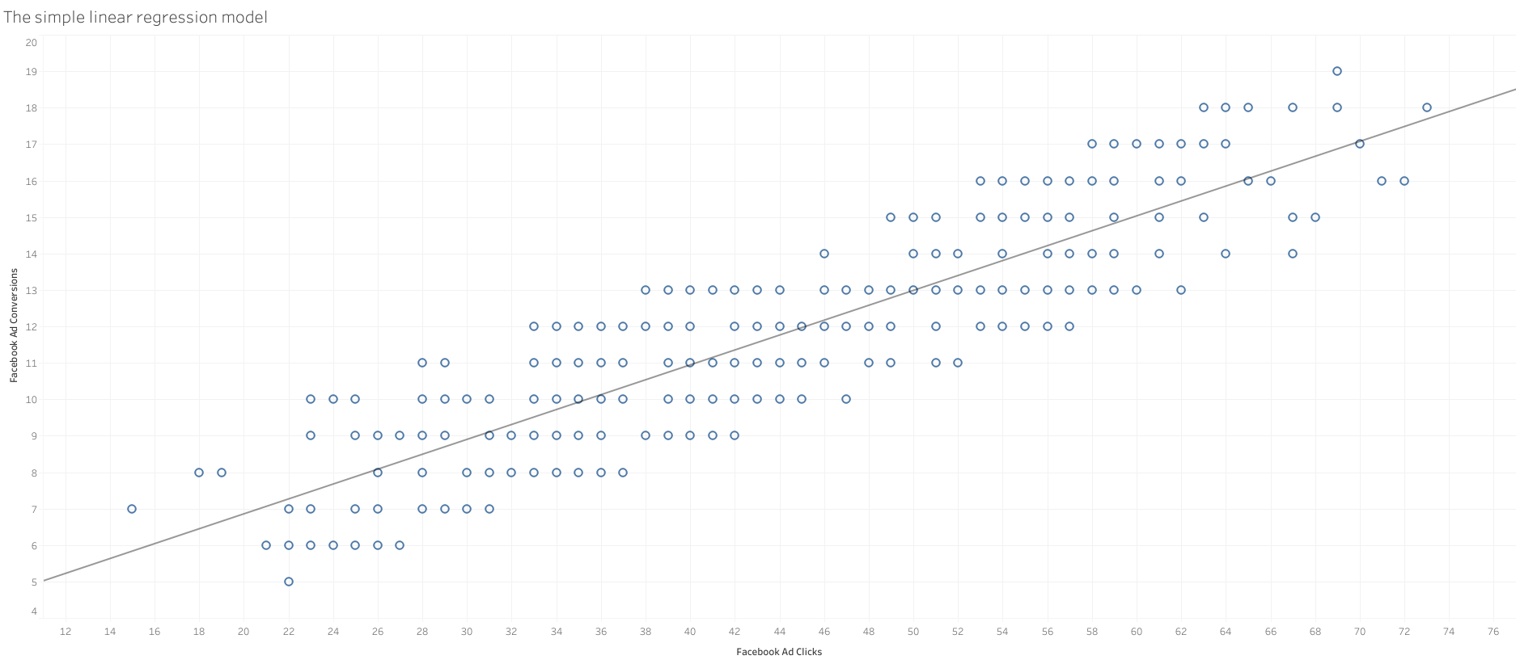
Modeling
Finally, include a visualization of your complete model.

Slide 19
End of Module 4

Slide 20
Final Insights
Now, knowing what you do about the results of your test, what are the final insights that you would share with your client? What did you learn and what would you recommend? Is there anything you would do differently next time?
From the model we can interpret that there is a strong positive correlation between the Facebook Ad Clicks and the Facebook Ad Conversions. This means that the more the number of clicks rises we will get more conversions from the Facebook campaigns.
Previously during our hypothesis testing we confirmed that the number of conversions will be greater if we advertise on Facebook platform rather than on the AdWords platform.
That’s why, we recommend increasing the Facebook budget compaigns optimized for clicks or reallocate a portion of the AdWords’ budget campaigns to Facebook campaigns to generate more conversions and ultimately increasing the client’s sales.

